Slide 1
How the Web Works

Slide 2
CERN
Conseil Européen pour la Recherche Nucléaire
1983: The discovery of W and Z bosons
1989: The determination of the number of light neutrino families
1999: The discovery of direct charge conjugation parity symmetry violation
2000: Discovered a new state of matter, the Quark Gluon Plasm
2012: A boson with mass around 125 GeV/c2 consistent with the long-sought Higgs boson

Slide 3
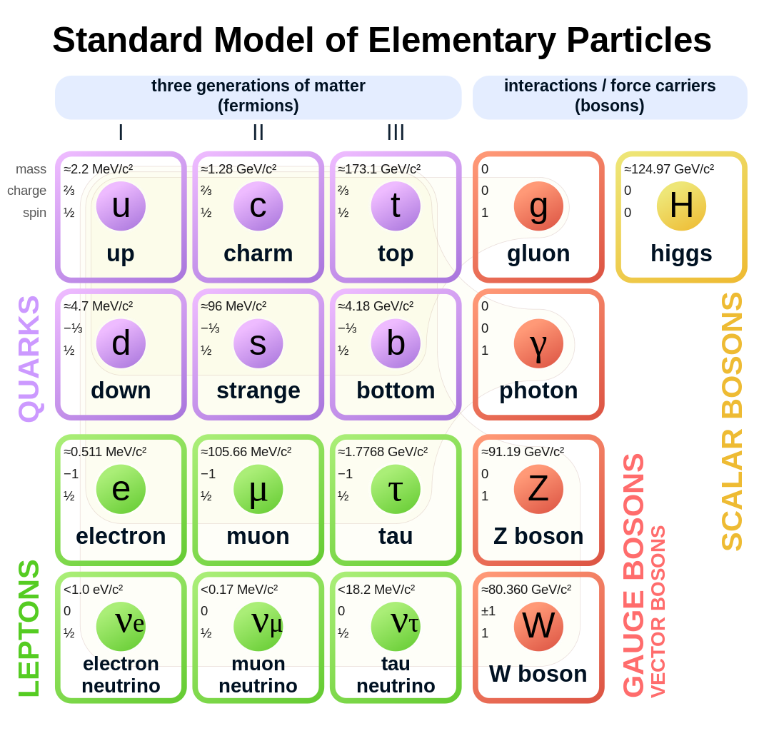

Slide 4
Notes:
By Coolcaesar at the English-language Wikipedia, CC BY-SA 3.0, https://commons.wikimedia.org/w/index.php?curid=395096

Slide 5
NeXT
Founded in 1985 by CEO Steve Jobs
~50,000 made
Apple purchased NeXT in 1997 for $427 million
macOS based on NexTSTEP
The kernel of NeXTSTEP is based upon the Mach kernel, which was originally developed at Carnegie Mellon University

Slide 6
Tim Berners-Lee (TimBL)
Combined several existing technologies to create a usable and flexible platform
Standard Generalized Markup Language (SGML), the basis of the Hyper Text Markup Language (HTML)
Hypertext
Client/server
TCP/IP

Slide 7
SGML
SGML descended from IBM's Generalized Markup Language (GML), which Charles Goldfarb, Edward Mosher, and Raymond Lorie developed in the 1960s
Goldfarb, editor of the international standard, coined the "GML" term using their surname initials
Now an ISO standard
Notes:
https://en.wikipedia.org/wiki/Standard_Generalized_Markup_Language

Slide 8
SGML Postulates
Declarative
Markup should describe a document's structure and other attributes rather than specify the processing that needs to be performed, because it is less likely to conflict with future developments
Rigorous
In order to allow markup to take advantage of the techniques available for processing, markup should rigorously define objects like programs and databases.

Slide 9
Hypertext
Term coined in 1963 by Ted Nelson to describe how documents can be connected to other documents via links
Founded Project Xanadu in 1960, with the goal of creating a computer network with a simple user interface
Notes:
https://en.wikipedia.org/wiki/Ted_Nelson

Slide 10
Client/Server
TimBL created the HyperText Transmission Protocol
Relatively simple and human readable
Very few commands
TCP/IP

Slide 11
Everywhere
Estimates put 70% of humans use the web
With IoT more devices than humans

Slide 12
Browsers
Original browser was also an editor and all pages were editable
Presaged wikis
In the early 1990's, the National Center for Supercomputer Applications (NCSA) at the University of Illinois Urbana-Champaign (UIUC) created both a browser (Mosaic) and a server (HTTPd)

Slide 13
Browsers
Mosaic become Netscape Navigator then Mozilla’s Firefox
HTTPd became the Apache server

Slide 14
Rendering Engines
Mozilla/Firefox: Gecko
Apple/Safari: Webkit
Google/Chrome forked from Webkit, now called Blink and used in Chromium (Chrome), Brave, etc.
Microsoft had its own (for IE) but now uses Blink/Chromium in Edge
Notes:
https://en.wikipedia.org/wiki/Browser_engine

Slide 15
Browser Wars
AOL etc. also had their own
Many were incompatible
Microsoft claimed could not remove browser
Proved wrong in court
World Wide Web Consortium (W3C) now creates many standard for the web

Slide 16
JavaScript
Created at Netscape in 1995
Mocha → LiveScript → JavaScript
Microsoft countered with (incompatible) JScript
Now standardized by the European Computer Manufacturers Association (ECMA)

Slide 17
Browser Tools
View Page Source
Developer tools

Slide 18
Developer Tools
Elements
Console
Sources
Network
Performance
Application
Security

Slide 20
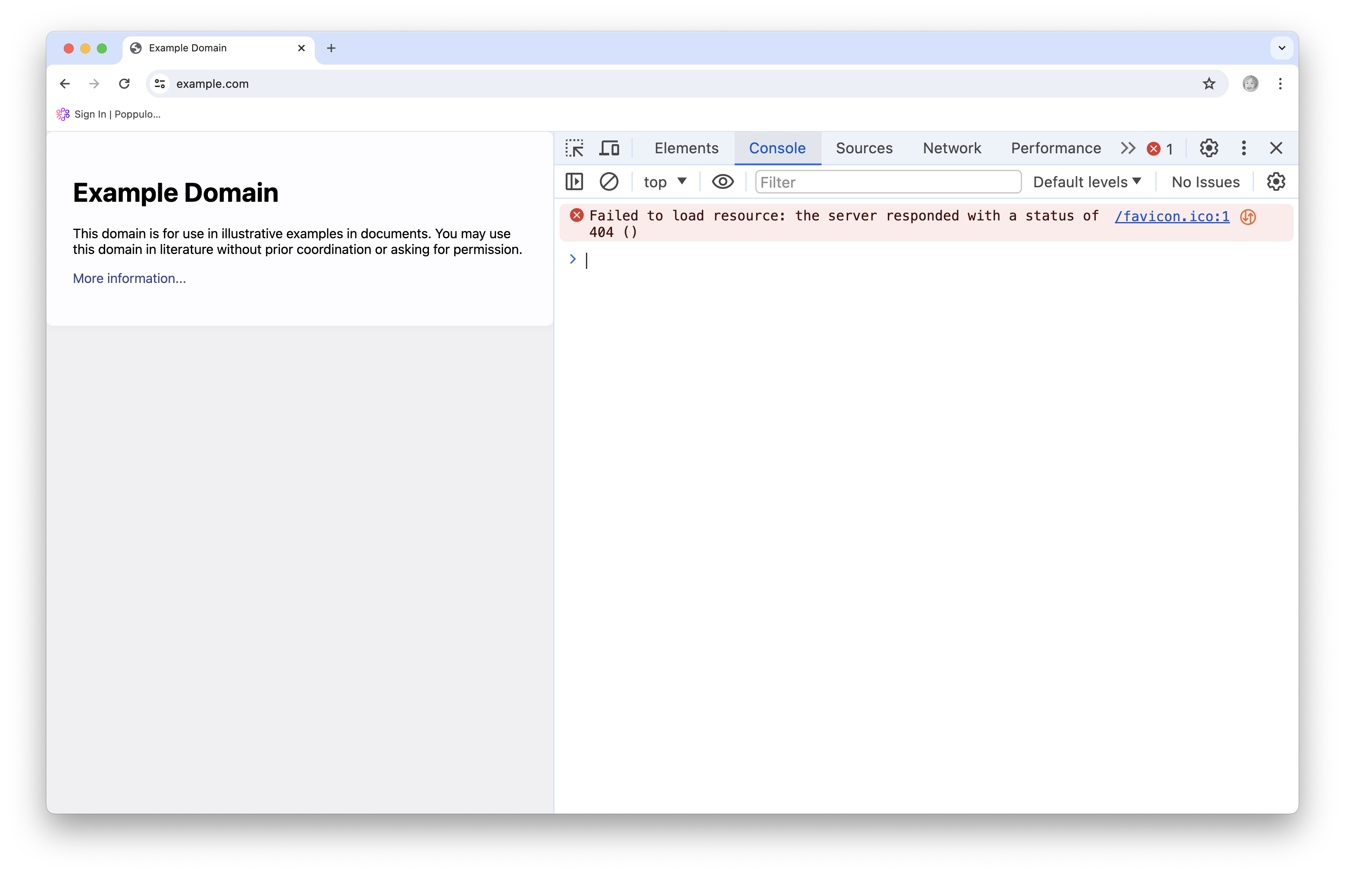

Slide 21
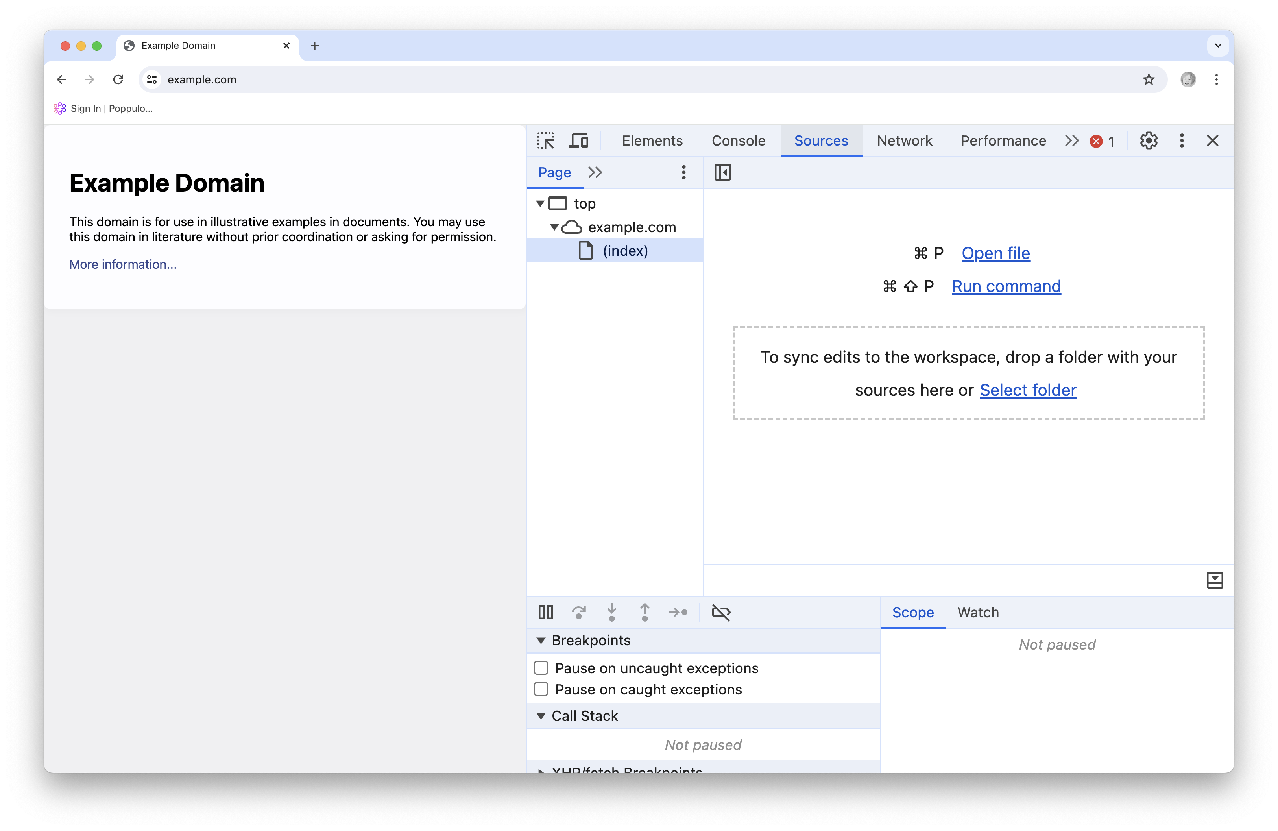

Slide 22
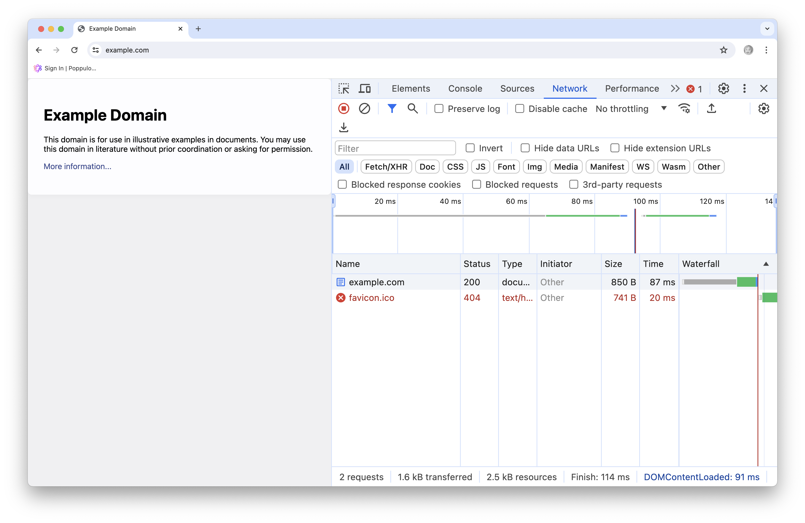

Slide 23
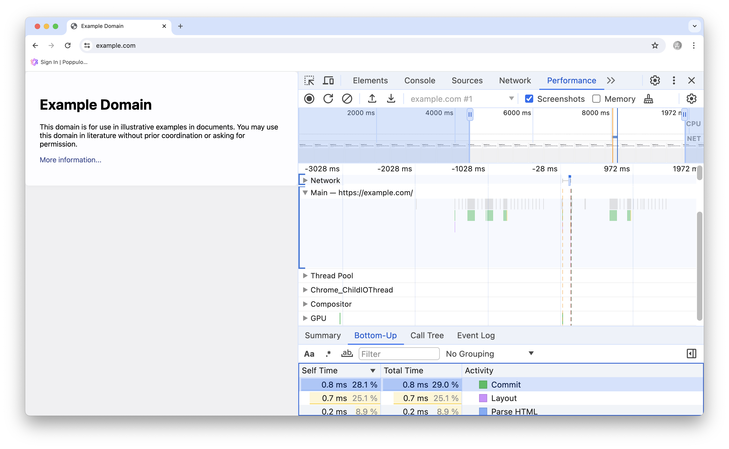

Slide 24
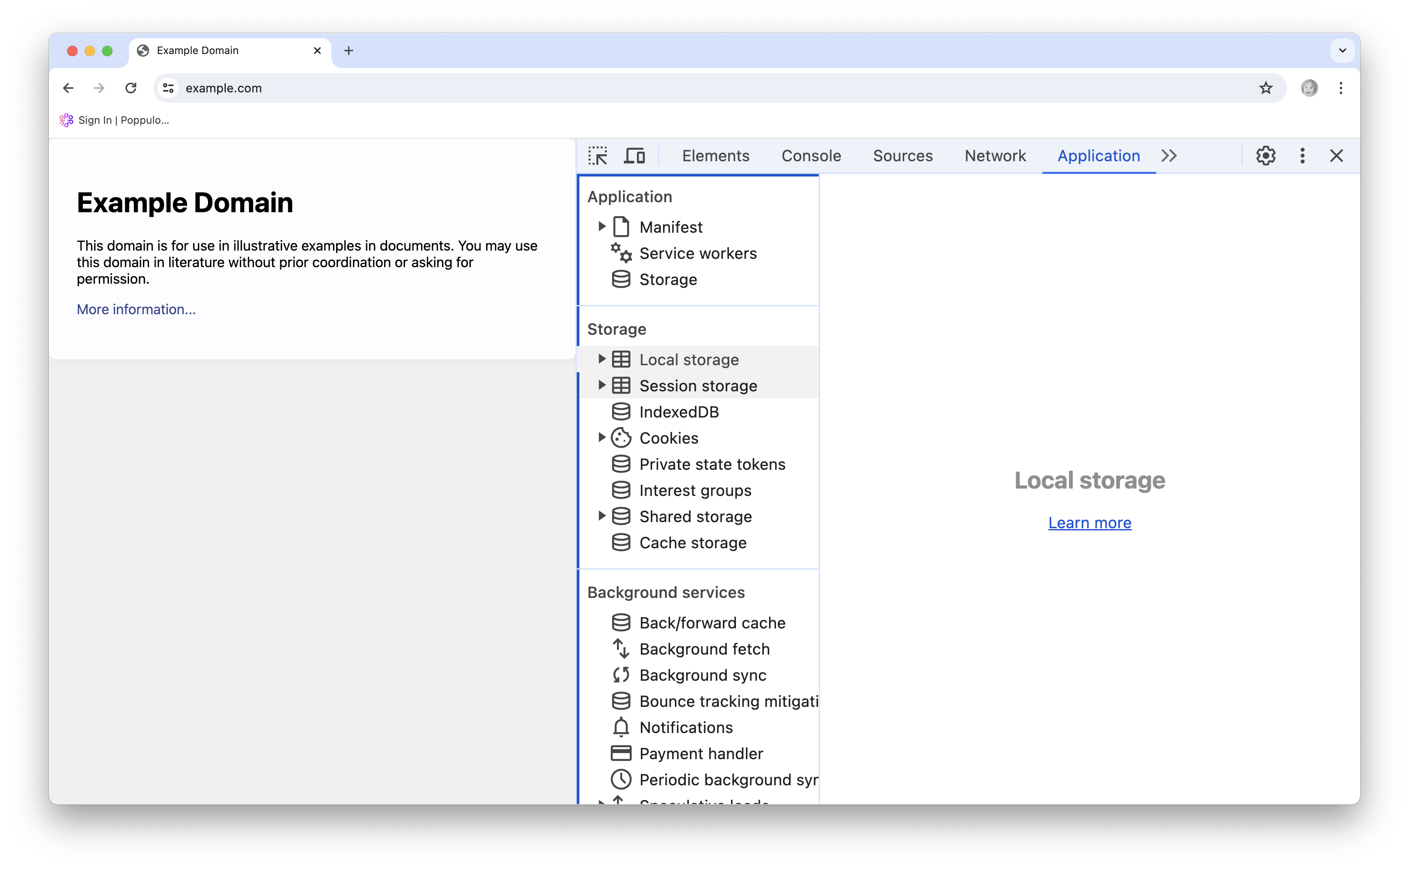

Slide 25
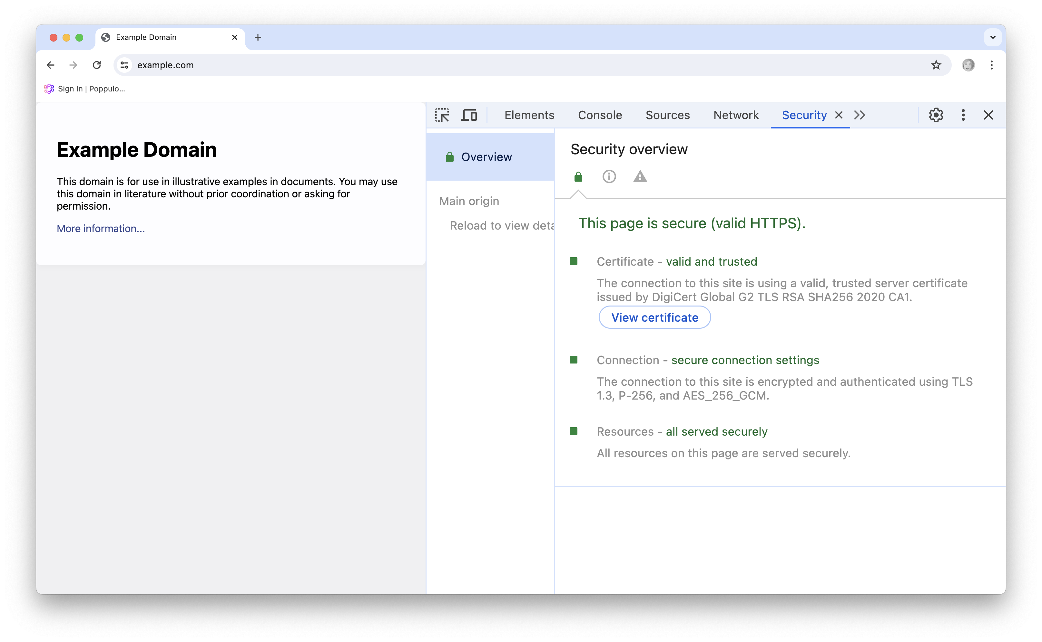

Slide 26
HTTP Versions
Initially used for text documents
Not the rich content we now have
HTTP/2 added resource pipelining for multiple requests to the same server
Not for sessions
Connection: keep-alive
Added server push for related content

Slide 27
HTTP Versions
HTTP/3 uses UDP and QUIC instead of TCP

Slide 28
HTTP Methods
GET
Request a resource
Safe, idempotent
HEAD
Request just the headers
Safe, idempotent

Slide 29
HTTP Methods
POST
Add a resource to a collection
Unsafe and non-idempotent
PUT
Modify an existing resource or create a new one
Idempotent

Slide 30
HTTP Methods
PATCH
Modify (part of) an existing resource
Idempotent
DELETE
Delete a resource
Non-idempotent

Slide 31
Requests and Responses
Requests and responses have the same form
a header with one or more lines
a blank line
a body
The body is optional for certain types of requests and responses

Slide 32
Request Headers
Accept: text/html,application/xhtml+xml,application/xml;q=0.9,
image/avif,image/webp,image/apng,*/*;q=0.8
Encoding: gzip, deflate, br
Accept-Language: en-US,en;q=0.9
Cache-Control: no-cache
Pragma: no-cache
Connection: keep-alive
Host: localhost:3000
User-Agent: Mozilla/5.0 (Macintosh; Intel Mac OS X 10_15_7) AppleWebKit/537.36 (KHTML, like Gecko) Chrome/108.0.0.0 Safari/537.36

Slide 33
Status Codes
The 100 codes are informational
The 200 codes are the success message
The 300 codes specify redirection
The 400 codes are client errors
The 500 codes are server errors

Slide 34
Response Headers
Content-Type: text/html; charset=utf-8
ETag: W/"95169fc2a0f58a5c49be68df615b2034”
Cache-Control: max-age=0, private, must-revalidate

