Slide 1
Chapter 02
Ruby for Rails

Slide 2
Ruby
Ruby is an interpreted, high-level, general-purpose programming language which supports multiple programming paradigms.
It was designed with an emphasis on programming productivity and simplicity.
In Ruby, everything is an object, including primitive data types. - Wikipedia
Creator: Yukihiro "Matz" Matsumoto (mid-1990s, Japan)

Slide 3
Why Ruby?
Ruby expresses complicated ideas succinctly
Key Benefits
Fewer lines written = fewer bugs written
Object-oriented with unique features
Features not found in many other languages
Expressive and readable

Slide 4
Learning Outcomes
By the end of this chapter, you will be able to:
Leverage the big four OOP principles for better design
Create appropriate APIs using encapsulation and visibility
Use Ruby's strengths to create readable, parsimonious programs
Apply knowledge to other programming languages

Slide 5
Key Terms
Abstraction - Hiding complexity
Encapsulation - Hiding implementation
Inheritance - Gaining functionality from parent classes
Polymorphism - Many shapes, same interface
Dynamic arrays - Auto-sizing arrays
Dictionaries - Key/value pairs (Hashes)
Symbols - Immutable identifiers
Scopes - Visibility

Slide 6
Object Oriented Programming

Slide 7
Why OOP?
The Challenge: Modern programs are too complex for humans to understand.
Miller's Law (1956)
"The Magical Number Seven, Plus or Minus Two”
https://www.musanim.com/miller1956/
Working memory: 7 ± 2 items
Beyond this, we cannot understand programs
Must narrow focus to manageable chunks
Need to abstract away details

Slide 8
Origins of OOP
Simula 67 (1967)
Introduced objects, classes, inheritance, virtual procedures, garbage collection
Smalltalk
Inspired by Simula 67
Ruby
Inspired by Smalltalk (and others)

Slide 9
Core OOP Concepts
Independent objects holding their own state
State = values object's variables hold
Objects expose services via public messages
Messages = methods
Classes = blueprints for objects
Instantiation = creating new objects

Slide 10
The Big Four of OOP
A, E, I, O+1
Mnemonic: The vowels (with off-by-one error)
A - Abstraction
E - Encapsulation
I - Inheritance
O+1 (P) - Polymorphism

Slide 11
Abstraction

Slide 12
A: Abstraction
Most important OOP principle
Need to abstract away from data details.
In the end, everything is numbers
Booleans = 1-bit numbers
Dates = multiple numbers
Images = files of numbers
Audio/video = numbers representing sounds/frames
Phone numbers = numbers or strings
But we don't want to care how data are stored

Slide 13
Abstraction in Practice
With dates, we don't want to know
Is day, month, or year stored first?
How are leap years handled?
How leap seconds work?
We just want
Date arithmetic that works
Invalid dates handled correctly
Assume implementation is correct

Slide 14
Creating Good APIs
Every class creates an Application Programming Interface (API)
Best Practices
Keep API as constant as possible
Clients know what to expect
Services that work (and we don't care how)
Underlying data/algorithms can change
Interface stays the same

Slide 15
Arrays in Ruby
Different from most languages
Store values of any type (all references to objects)
Dynamically sized (auto-grow/shrink)
Gaps filled with ‘nil’
0-based indexing
Negative indices from end
Slices using indices or ranges

Slide 16
Unconventional Operations
Set: intersection, union, difference
Queue: push, pop, shift, unshift
Enumerable: map, each, find, select, grep, sort
Functional Programming
Most methods take blocks for functional operations

Slide 17
A Few Examples
irb> a = [/regex/]
=> [/regex/]
irb> a[5] = "foo"
=> "foo"
irb> a
=> [/regex/, nil, nil, nil, nil, "foo"]
irb> a.pop
=> "foo"
irb> a.compact
=> [/regex/]
irb> b = (0..5).to_a
=> [0, 1, 2, 3, 4, 5]
irb> b.map{|i| i*i}
=> [0, 1, 4, 9, 16, 25]
irb> b.filter{|i| i > 3}
=> [4, 5]

Slide 18
Set Operations
irb> c = (0..5).to_a
=> [0, 1, 2, 3, 4, 5]
irb> d = (4..10).to_a
=> [4, 5, 6, 7, 8, 9, 10]
irb> c.union(d)
=> [0, 1, 2, 3, 4, 5, 6, 7, 8, 9, 10]
irb> c.intersection(d)
=> [4, 5]
irb> c.difference(d)
=> [0, 1, 2, 3]
irb> c[-1]
=> 5
irb> c[3,2]
=> [3, 4]

Slide 19
Symbols
Begin with : sigil
:symbol_name
Characteristics
Creates global identifier (not a variable)
Is an object
Cannot assign to or change once created
Added to global set named Symbol
Similar to a dynamic global enumeration
Rails uses symbols extensively for parameters

Slide 20
Hashes
Key/value pairs, aka associative arrays, maps, hashes
Properties
Values accessed by key
Keys must be unique
Values can duplicate
Last assignment wins
Any object with hash method can be key (including nil, regex)

Slide 21
Hash Examples
irb> a = {"a" => "b"}
=> {"a"=>"b"}
irb> a = {:a => "b"}
=> {:a=>"b"}
irb> a = {a: "b"} # Symbol shorthand
=> {:a=>"b"}
irb> a = {1 => "one"}
=> {1=>"one"}
irb> a = {/regex/ => "regex"}
=> {/regex/=>"regex"}
irb> a = {nil => "nil"}
=> {nil=>"nil"}
irb> a = {a: "eh", b: "bee", c: "see"}
=> {:a=>"eh", :b=>"bee", :c=>"see"}
irb> a[:a]
=> "eh"

Slide 22
Encapsulation

Slide 23
The E: Encapsulation
Helps with abstraction and complexity.
Historical Context
Unstructured code → Dijkstra's "Go To Statement Considered Harmful" (1968)
Shared mutable data = "go-tos" of data world
Cannot count on values (may be changed by others)
Thread-safety issues
Solution: Hide implementation details

Slide 24
Why Encapsulate?
Referential Transparency
Calculated value ↔ constant value (interchangeable)
Don't care how service is provided
Implementation can change
Interface stays the same
Clients don't notice difference
Object behavior shouldn't change during lifetime

Slide 25
Encapsulation Guidelines
All variables private/protected - no direct writing by other objects
All methods reference all variables giving high coherence
Loosely coupled classes not tightly tied to implementations
Read-only accessors - no mutators

Slide 26
Sigils
Ruby uses sigils for scope
UInique approach
A sigil is a type of symbol used in magic
Notes:
https://en.wikipedia.org/wiki/Sigil

Slide 27
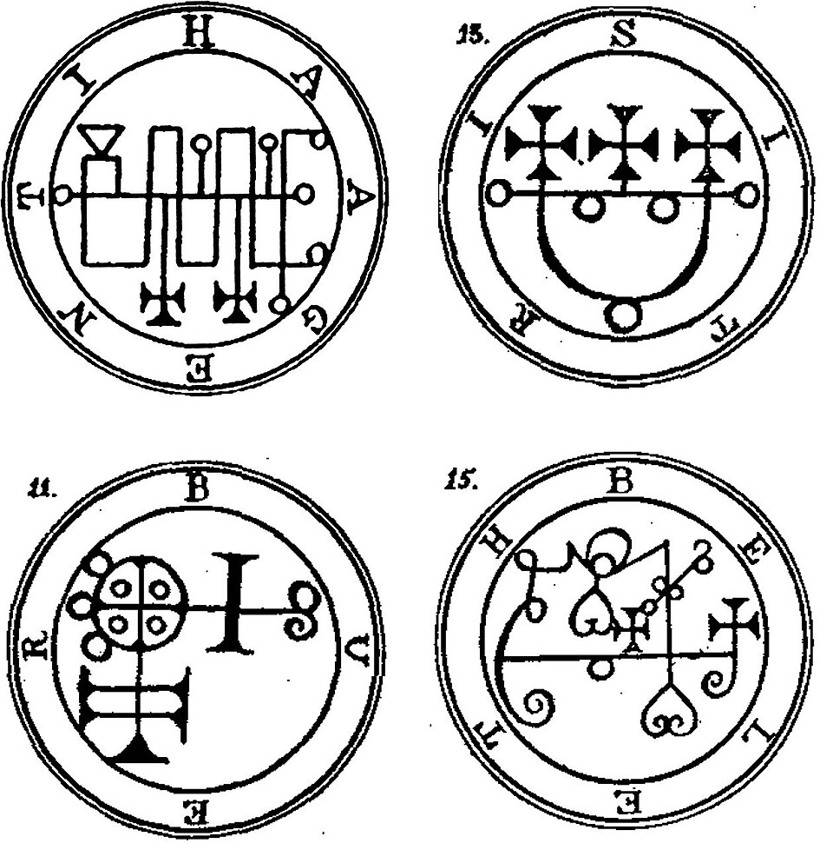
Goetic seals from the Lesser Key of Solomon
Notes:
https://commons.wikimedia.org/wiki/File:Goetia_seals.jpg

Slide 28
Scopes and Sigils
$global - Global variables
@@class - Class variables
@instance - Instance variables
:symbol - Symbols
local - Local variables (block scope)
Defaults
Class/instance variables: private
Methods: public

Slide 29
Visibility Modifiers
Methods
public
private
protected
For instance variables
attr_reader - read-only
attr_writer - write-only
attr_accessor - read and write

Slide 30
Scope Example
$global = "global"
local = "local"
class Demo
@@class = "class"
def initialize
@instance = "instance"
end
def scope
method_local = ”local"
# Access all scopes here
end
end
demo = Demo.new
demo.scope

Slide 31
Inheritance

Slide 32
The I: Inheritance
Classes gain functionality from parent (super) classes.
Key Concepts
Child/derived class extends base/parent class
Access to public and protected members
Use with caution (less flexible than composition)
Is-a vs Has-a
Cat is-a mammal is-an animal
SortedList has-a List (not is-a)

Slide 33
Ruby's Approach
Single Inheritance
Inherit from one class only
Easier to understand than multiple inheritance
Limits flexibility
Mixins
Alternative way to gain functionality
Uses modules
Mixins are more flexible than multiple inheritance
Syntax
class Child < Parent

Slide 34
Example
class Animal
TRAITS = ["eat", "breathe", "move", "reproduce"]
def method_missing(m, *args, &block)
TRAITS.include?("#{m}".sub(/\?/, ""))
end
end

Slide 35
Example
class Mammal < Animal
TRAITS = ["fur", "hair", "lactate"]
def method_missing(m, *args, &block)
if TRAITS.include?("#{m}".sub(/\?/, ""))
true
else
super(m, *args, &block)
end
end
end

Slide 36
Example
class Cat < Mammal
TRAITS = ["claws", "sharp_teeth"]
def method_missing(m, *args, &block)
if TRAITS.include?("#{m}".sub(/\?/, ""))
true
else
super(m, *args, &block)
end
end
end

Slide 37
Modules (Mixins)
module Conversions
@@F2C = 5/9.0
@@C2F = 9/5.0
def c2f(celsius)
(celsius * @@C2F) + 32
end
def f2c(fahrenheit)
(fahrenheit - 32) * @@F2C
end
end
include Conversions
p f2c(212) # => 100.0
p c2f(100) # => 212.0

Slide 38
Polymorphism

Slide 39
The O+1 (P): Polymorphism
From Greek "many shapes"
Methods take different types and perform same operations

Slide 40
Sort Polymorphism
irb> ["5", "2", "1"].sort
=> ["1", "2", "5"]
irb> [5, 2, 1].sort
=> [1, 2, 5]
irb> arr = ['5', 1, '2', 4, 3]
=> ["5", 1, "2", 4, 3]
irb> arr.sort{ |x, y| x.to_i <=> y.to_i }
=> [1, "2", 3, 4, "5"]
Notes:
UFO operator

Slide 41
Debugging

Slide 42
Rails Debugging
Everyone writes bugs
Become an expert at debugging.
Tools Available
Browser developer console
Server logs
Built-in debugging shell
Activate Debugger
Add to Gemfile gem 'debug’
Call in code debugger

Slide 43
Debug Commands
break - List/set breakpoints
N - line number N in current file
F:N - file F, line N
C#M - class C, method M
delete - Delete breakpoints
info - Show Rails variables
step - Step into next line
next - Go to next line (don't step into)
continue - Resume until next breakpoint

Slide 44
Example
# POST /items
def create
@item = Item.new(item_params)
debugger
# [...]
end
(rdbg) p item_params
Unpermitted parameter: :priority
(rdbg) p @item
=> #<Item id: nil, what: "Melissa", priority: nil>
(ruby) @item.priority=5
5
(rdbg) c

Slide 45
Summary

Slide 46
What We Learned
Big Four OOP: Abstraction, Encapsulation, Inheritance, Polymorphism
Ruby Arrays: Dynamic, powerful, many operations
Symbols: Immutable global identifiers
Hashes: Key/value pairs with flexible keys
Scopes: Using sigils ($, @@, @, :)
Debugging: Built-in tools and commands

