Slide 1
Chapter 06
Security

Slide 2
Text Conventions
Ruby code in fixed-width font and indented
  root "items#index”
Command lines start with '$', are in a fixed-width font, and are not indented
$ ls -lta

Slide 3
Sun Tzu, The Art of War
If you know the enemy and know yourself, you need not fear the result of a hundred battles
If you know yourself but not the enemy, for every victory gained you will also suffer a defeat
If you know neither the enemy nor yourself, you will succumb in every battle.

Slide 4
The Security Challenge
Common Vulnerabilities and Exposures (CVE) database (https://www.cve.org/)
  40,077 a year = ~110 new vulnerabilities per day
  19,600 SQL vulnerabilities
  39,497 cross-site scripting exposures
  Everyone’s favorites
    https://www.cve.org/CVERecord?id=CVE-2005-0036 https://www.cve.org/CVERecord?id=CVE-2005-0037 https://www.cve.org/CVERecord?id=CVE-2005-0038
As more IoT devices have built-in web servers, our attack surface increases along with our responsibility.

Slide 5
Learning Outcomes
By the end of this chapter, you will be able to
  Create secure applications resistant to SQL and XSS injections
  Generate applications requiring authentication and authorization
  Construct applications with data encrypted at rest and in flight
  Augment your server with CORS directives
  Browse the dark web

Slide 6
Key Terms
Authentication - Proving who you are
Authorization - What you're allowed to do
Encryption at rest and in transit - Data protection
Static and dynamic code analysis - Security testing
Injections - Malicious input attacks
The dark web - Anonymous internet overlay

Slide 7
DB Encryption

Slide 8
Active Record Encryption
Sensitive data should be encrypted so that when exfiltrated, it cannot be read.
Two Types of Encryption:
  Non-deterministic - Same text produces different encrypted output
  Deterministic - Same text always produces the same encrypted output

Slide 9
Choosing Encryption Types
Non-Deterministic
  Stronger security
  Cannot search encrypted fields
Deterministic:
  Allows searching
  Slightly weaker security

Slide 10
Initialize Encryption Keys
  bin/rails db:encryption:init
Output
  active_record_encryption:
  primary_key: a77fQ0lBeMehQtOaDy0m0vWVTLRBvInQ
  deterministic_key: cXf5O9hIpZuySQDuAxY4H8pk6aL3aduk
  key_derivation_salt: LbZooLJhrUCdqWliVxlwgcqmOtPsQnRN
Warning: Don't use these exact keys in production of course

Slide 11
Configure Credentials
Add the encryption keys to your credentials
  bin/rails credentials:edit
Add the four lines from initialization output
Now ready to encrypt model fields

Slide 12
Encrypt Model Attributes
In app/models/item.rb
  encrypts :what
Or
  encrypts :what, deterministic: true

Slide 13
What Encrypted Data Looks Like
  INSERT INTO items
  VALUES(1,'{"p":"pe8n","h":{"iv":"yFiXHOKTlDoMTszy",
  "at":"1HVSccg9M2qzSla/sdD+lQ=="}}',
  '2023-04-19','2023-04-19 10:46:30.880533',
  '2023-04-19 10:46:30.880533');
Data are now protected even when the database is compromised

Slide 14
Fix Tests with Encrypted Data
Tests assume unencrypted fixture data
Add to `config/environments/test.rb`
  config.active_record.encryption.encrypt_fixtures = true
This makes tests work with encrypted fixtures

Slide 15
Authentication

Slide 16
Auth/n vs Auth/z
Authentication (auth/n):
  Proving who you are
Authorization (auth/z):
  What you're allowed to do
Important: These are different concepts

Slide 17
Three Authentication Factors
Something you know
  Passwords, PINs
Something you have
  Phone, passport, driver's license
Something you are
  Biometrics: fingerprint, facial recognition
MFA/2FA: Uses more than one factor (e.g., password + text message)

Slide 18
Devise Authentication Gem
GitHub: https://github.com/heartcombo/devise
Features
  Local database storage OR external authenticators (OmniAuth)
  Email confirmation and password recovery
  Login tracking and failed attempt locking
  Session timeout configuration
Best practice: Use external authenticators to avoid storing credentials

Slide 19
Setting Up Devise
  bundle add devise
  rails generate devise:install
  rails generate devise User
Configure features in:
  app/models/user.rb
  db/migrate/[...]_devise_create_users.rb
  config/initializers/devise.rb

Slide 20
Devise Route Setup
Must have default route in ‘config/routes.rb’
  root "items#index"
In controllers requiring authentication:
  before_action :authenticate_user!

Slide 21
Adding Logout Functionality
In your HTML/ERB files
  <%= link_to "Log out", destroy_user_session_path, data: { "turbo-method": :delete } %>
  <%= button_to "Log out", destroy_user_session_path, method: :delete %>
  This creates a logout link that properly destroys the session

Slide 22
Devise Test Helpers
At the top of controller tests:
  class ItemsControllerTest < ActionDispatch::IntegrationTest
  include Devise::Test::IntegrationHelpers
  setup do
  sign_in users(:one)
  @item = items(:one)
  end
  end

Slide 23
Authorization

Slide 24
CanCanCan Authorization Gem
GitHub: https://github.com/CanCanCommunity/cancancan
Ability-Based Approach
  Decouples users from permissions
  More flexible than role-based
  Integrates well with Devise
  Decisions based on many factors

Slide 25
Setting Up CanCanCan
Assuming Devise is already installed:
$ bundle add cancancan
$ rails generate cancan:ability
Creates `app/models/ability.rb` for defining permissions.

Slide 26
Basic Ability Configuration
In `app/models/ability.rb`:
  class Ability
  include CanCan::Ability
  def initialize(user)
  return unless user.present?
  can :read, :all
  end
  end
Only allows reading if user is logged in.

Slide 27
Using CanCanCan in Controllers
In ‘app/controllers/posts_controller.rb’
  class PostsController < ApplicationController
  before_action :authenticate_user!
  before_action :set_post, only: %i[show edit update destroy]
  load_and_authorize_resource
  end
This is a simplistic example - CanCanCan allows much more flexibility

Slide 28
HTTPS

Slide 29
Securing Data in Transit
Never use HTTP for production applications
HTTPS keeps all data secure during transmission.
Need
  Public/private key pair
  Certificate
  Self-signed for dev, CA-signed for production

Slide 30
Generate SSL Certificate
Using OpenSSL
$ openssl req -x509 -sha256 -nodes \
-newkey rsa:2048 -days 365 \
-keyout localhost.key -out localhost.crt
‘.key’ file = private key (keep secret)
‘.crt’ file = self-signed certificate
Warning: Never commit private key to public repositories

Slide 31
Certificate Information
When creating certificate, answer these questions
Country Name (2 letter code) []:
State or Province Name (full name) []:
Locality Name (eg, city) []:
Organization Name (eg, company) []:
Organizational Unit Name (eg, section) []:
Common Name (eg, fully qualified host name) []:
Email Address []:
For local development, accuracy doesn't matter much.

Slide 32
Run Rails with SSL
$ rails s -b 'ssl://localhost:3000?key=localhost.key&cert=localhost.crt'
‘-b’ binds to a specific port
Processes key and certificate files
Now accessible at `https://localhost:3000/`

Slide 33
Certificate Trust Warning
When visiting https://localhost:3000/
Your connection is not private
Attackers might be trying to steal your information
NET::ERR_CERT_AUTHORITY_INVALID
Why? Browser doesn't trust self-signed certificates
Solution: Click "Advanced" and proceed (dev only)

Slide 34
Connection is Actually Encrypted
Even with the warning, connection uses:
  TLS_AES_256_GCM_SHA384
  256-bit keys
  TLS 1.3
Data are encrypted, just not validated by Certificate Authority.

Slide 35
Certificate Authorities (CA)
For production, need CA-signed certificate
Let's Encrypt
  Free, trusted certificates
  https://letsencrypt.org/
  No reason to deploy unencrypted
Each server/deployment has a different setup approach
chrome://certificate-manager/crscerts

Slide 36
Browser Security

Slide 37
Same-Origin Policy (SOP)
Browsers trust content from sites they explicitly visit
Origin = scheme + host + port
Example: http://www.example.com/pathA
Matches
  http://www.example.com/pathB
Does not Match
  https://www.example.com/pathA (different scheme)
  http://host.example.com/pathA (different host)
  http://www.example.com:3000/pathA (different port)

Slide 38
What SOP Allows
Scripts: `<script src="..."></script>`
CSS: `<link rel="stylesheet" ...>`
Media: `<img>`, `<video>`, `<audio>`
Form submission with complete URL
Why allow these?
  Pervasive use (and CDNs) - blocking would break the web

Slide 39
SOP Can Block APIs
Example: SPA at `localhost:3001` requests data from `localhost:3000`
Browser console error
  Cross-Origin Request Blocked: The Same Origin Policy disallows
  reading the remote resource at http://localhost:3000/items.json.
  (Reason: CORS header 'Access-Control-Allow-Origin' missing).
Note: SOP is a browser restriction, not a server restriction

Slide 40
Cross-Origin Resource Sharing
HTTP header-based approach for servers to share trusted resources with browsers
Purpose: Allow controlled violations of SOP
For Rails: Rack CORS gem
  https://github.com/cyu/rack-cors

Slide 41
Setting Up CORS
$ bundle add rack-cors
Create configuration in `config/initializers/cors.rb`:
  Rails.application.config.middleware.insert_before 0, Rack::Cors do
  allow do
  origins "localhost:3001"
  resource "*",
  headers: :any,
  methods: [:get, :post, :put, :patch, :delete, :options, :head]
  end
  end

Slide 42
CORS Security Tips
Don't wildcard origins
origins "*" # BAD Allows scripts from anywhere
Do specify exact origins
origins "localhost:3001", "example.com" # GOOD
Tighten access to specific resources and methods as needed.

Slide 43
CORS Headers in Action
Request
  GET /items.json HTTP/1.1
  Host: localhost:3000
  Origin: http://localhost:3001
Response
  HTTP/1.1 200 OK
  access-control-allow-origin: http://localhost:3001
  access-control-allow-methods: GET, POST, PUT, PATCH, DELETE, OPTIONS, HEAD

Slide 44
Avoiding CORS Issues
Place scripts in:
  ‘public’ directory
  ‘app/javascript/’ directory
Scripts don't cross origins, no CORS errors.

Slide 45
Injections

Slide 46
Injection Attacks
Use specially crafted input to:
  Expose data
  Trick users into entering personal information
Types
  SQL Injection (SQLi)
  Cross-Site Scripting (XSS)
  Cross-Site Request Forgery (CSRF)

Slide 47
SQL Injection (SQLi)
Works against many databases, not just SQL.
Normal Query
  SELECT * FROM person WHERE email='alice@example.com'
Injected Query
  SELECT * FROM person WHERE email='foo' OR '1' = '1'
Returns ALL records
  Tautology '1' = '1' is always true

Slide 48
Real-World SQLi Attack
<%= form.search_field(:query, value: params[:query]) %>
Vulnerable controller:
Person.where("email LIKE '%#{params[:query]}%'")
Attacker enters foo' OR '%' = '
Resulting query:
SELECT * FROM people WHERE (email LIKE '%foo' OR '%' = '%')
All people returned

Slide 49
Rails SQLi Protection
Use ? placeholder in queries:
Vulnerable
Person.where("email LIKE '%#{params[:query]}%'")
Protected
Person.where("email LIKE ?", "%#{params[:query]}%")
The `?` invokes Rails' built-in SQLi protection

Slide 50
Code Analysis Tools

Slide 51
Program Analysis Tools
Static Analysis
  Analyzes code before running
  Looks at written code for typical errors
  Brakeman, Rubocop
Dynamic Analysis
  Analyzes while program runs
  Traces execution of instructions
  Emphasizes memory, performance issues

Slide 52
Brakeman Static Analysis
Rails-specific security analysis tool
$ gem install brakeman
$ brakeman # Run in application directory
Example Output
Confidence: High
Category: SQL Injection
Message: Possible SQL injection
Code: Person.where("email LIKE '%#{params[:query]}%'")
File: app/controllers/people_controller.rb
Line: 20

Slide 53
RuboCop for Rails
GitHub: https://github.com/rubocop/rubocop-rails
Analyzes wide variety of Ruby and Rails concerns:
  Code style
  Security issues
  Performance problems
  Best practices
Include in CI/CD workflows

Slide 54
Protecting User Data
Web applications gather Personally Identifiable Information (PII).
We are morally bound to protect that data to the best of our ability.
Learn More
  ZAP: https://www.zaproxy.org/
  WebGoat: https://owasp.org/www-project-webgoat/

Slide 55
Cross-Site Scripting (XSS)
Bad actor injects script into text field.
When another user displays the text, script runs in their browser.
Why it works
  Browsers trust content from sites via Same-Origin Policy (SOP)

Slide 56
XSS Attack Scenario
User enters in comment field:
<script>alert("XSS!")</script>
When someone else reads the comment, the script executes
What scripts can do
  Modify all page content
  Access site history
  Redirect to different sites
  Steal credentials

Slide 57
Built-In XSS Defense
Rails automatically escapes XSS scripts before displaying
Scripts persist in database but are escaped in views
How to Subvert
<%== person.name %>
<%= person.name.html_safe %>
<%= raw person.name %>

Slide 58
CSRF

Slide 59
Cross-Site Request Forgery
One webpage sends a request to another website
Typically relies on the user being logged in to target site
Two Types
  Web bugs (GET requests) - tracking
  Malicious actions (POST/PUT/PATCH/DELETE)

Slide 60
Web Bug Demo
HTML page with invisible image:
  <!DOCTYPE HTML>
  <html>
  <head><title>Web bug demo</title></head>
  <body>
  <img src="http://localhost:3000/people/1"
  width="0" height="0" border="0">
  </body>
  </html>
Request is sent with all identifying information (IP, cookies, etc.)
Used for tracking users across websites for targeted ads

Slide 61
Overriding Rails’ Protection
skip_forgery_protection if Rails.env.development?

Slide 62
CSRF Attack Example
Webpage that auto-submits DELETE:
  <!DOCTYPE HTML>
  <html>
  <head><title>CSRF</title></head>
  <body onload="document.forms[0].submit()">
  <form action="http://localhost:3000/people/1" method="POST">
  <input type="hidden" name="_method" value="delete" />
  </form>
  </body>
  </html>

Slide 63
Rails Defense Mechanism
Rails console output:
  Started DELETE "/people/1" for ::1
  Processing by PeopleController#destroy as HTML
  Can't verify CSRF token authenticity.
  Completed 422 Unprocessable Entity
Why it failed: Rails checks authenticity token

Slide 64
How Rails Prevents CSRF
Rails adds a hidden authenticity token to forms:
  <input type="hidden”
  name="authenticity_token”
  value="CaJ0OO...”
  autocomplete="off" />
Token changes each time the form loads
Attack sites don't know the token
Can't send valid requests without it

Slide 65
Additional CSRF Defenses
Sensitive sites use multiple techniques
  Single-use tokens
    “nonce” refers to a single-use value in cryptography
  Encourage logout when done
  Force logout after inactivity
  Session validation
  Transaction confirmation
Always log out of sensitive sites

Slide 66
The Dark Web

Slide 67
Surface, Deep, and Dark Web
Surface Web
  Available to everyone
  Indexed by search engines
Deep Web
  Requires credentials
  School, financial, and medical accounts
  Larger than the surface web
Dark Web:
  Requires a special browser (TOR)
  Anonymous communication

Slide 68
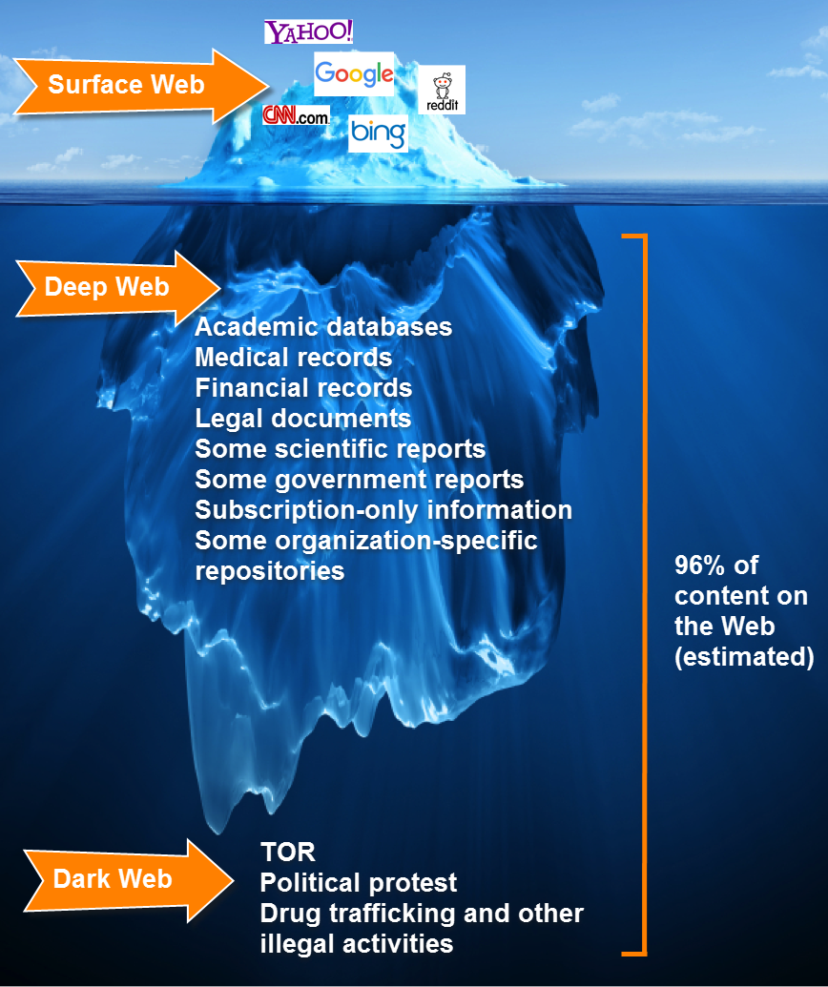

Slide 69
TOR = The Onion Router
https://www.torproject.org/download/
Site blocked at MSU Denver

Slide 70
Purpose
Send information through multiple machines to anonymize communication
An overlay network on top of the regular internet

Slide 71
Architecture
Three types of nodes
Guard - Where browser initially connects
Middle - Anonymizes communication (any number)
Exit - Where circuit exits to regular web
Circuits typically change every ~10 minutes

Slide 72
How TOR Works
Packet has multiple layers of encrypted routing
  Each node decrypts one layer (like peeling an onion)
  Each node knows only previous and next router
  After two hops, origin/destination cannot be derived
Result: Effectively anonymous communication

Slide 73
Alice, Bob, and Carol (A, B, C)
The Alice and Bob characters were invented by Ron Rivest, Adi Shamir, and Leonard Adleman in their 1978 paper A Method for Obtaining Digital Signatures and Public-key Cryptosystems
Notes:
https://en.wikipedia.org/wiki/Alice_and_Bob

Slide 74
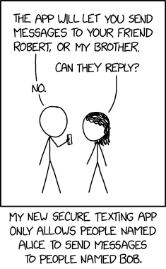
Obligatory
Notes:
https://xkcd.com/2691

Slide 75
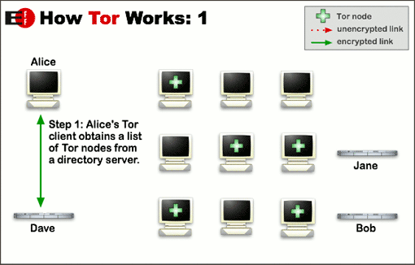

Slide 76
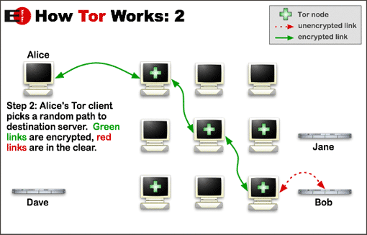

Slide 77
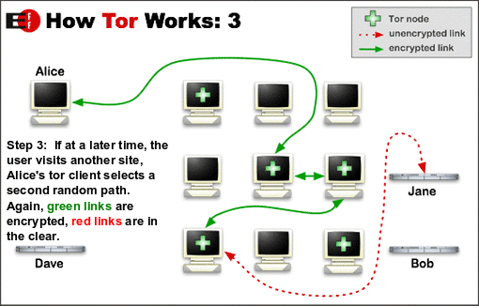

Slide 78
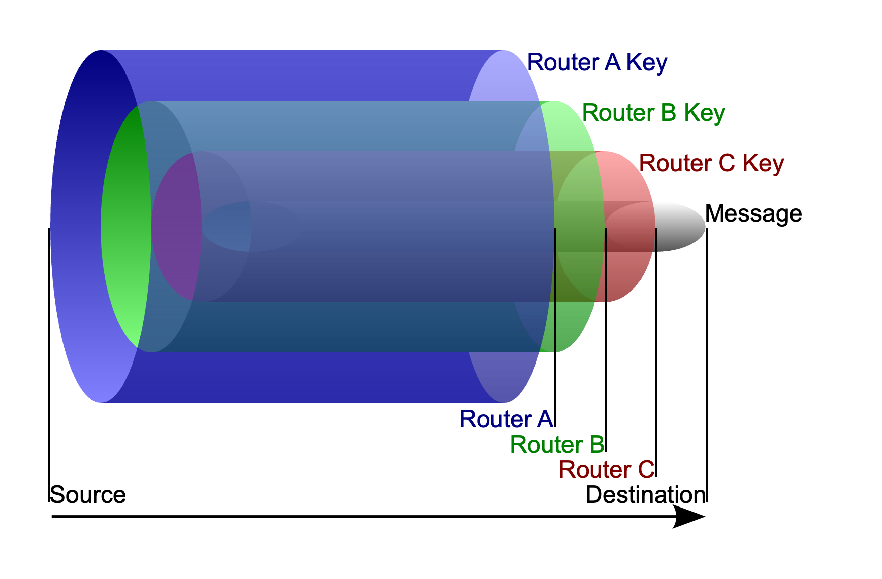

Slide 79
Opaque Envelopes
A’s
Encrypted
Message
From: A
To: B
From: B
To: C
From: C
To: D
A’s
Encrypted
Message

Slide 80
Why Use TOR?
Legitimate Uses
  Browse web anonymously
  Protect privacy
  Bypass censorship
  Journalist, whistleblower protection
Main Use Case:
  Access hidden services in the dark web.

Slide 81
Interesting TOR Facts
Created by U.S. Naval Research Laboratory
Still funded by U.S. government
Opened to public to decrease signal-to-noise ratio
Bitcoin greatly accelerated dark web use
Some markets have been infiltrated by law enforcement

Slide 82
Dark Web Services
TOR allows creating hidden services
  Web servers
  Chat servers
  Email servers
  Any service on surface web
Addresses end in .onion
Many are illegal on surface web (illicit markets, etc.)

Slide 83
Toby’s Site
http://yvudsnnux372gj2nvg3bnkficwf4niel6drfqyhbtglgdsf2l75xfqqd.onion/

Slide 84
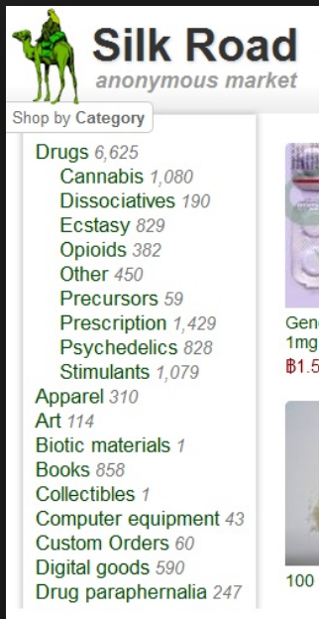

Slide 85
Ross Ulbricht
Dread Pirate Roberts
  From The Princess Bride
In 2015, he was convicted of engaging in a continuing criminal enterprise, distributing narcotics by means of the internet, conspiracy to commit money laundering, conspiracy to traffic fraudulent identity documents, and conspiracy to commit computer hacking
He was sentenced to double life in prison plus 40 years without the possibility of parole
After serving 12 years, he was released from prison in January 2025, when he received a full and unconditional pardon from U.S. President Donald Trump
Notes:
https://en.wikipedia.org/wiki/Ross_Ulbricht

Slide 86
Ross Ulbricht
Ulbricht attended the University of Texas at Dallas on a full academic scholarship and graduated in 2006 with a bachelor's degree in physics
Ulbricht received an additional scholarship to attend Pennsylvania State University, where he was in a master's degree program in materials science and engineering and studied crystallography

Slide 87
Tracking
Law enforcement seized a Silk Road server in Iceland
Ulbricht was connected to "Dread Pirate Roberts" by Gary Alford, an Internal Revenue Service investigator working with the Drug Enforcement Administration on the Silk Road case, in mid-2013
The connection was made by linking the username "altoid", used during Silk Road's early days to announce the website, and a forum post in which Ulbricht, posting under the nickname "altoid", asked for programming help and gave his email address, which contained his full name

Slide 88


Slide 89
Silk Road 2
Silk Road 2.0 came online, run by former administrators of Silk Road
It too was shut down and the alleged operator was arrested
Notes:
https://en.wikipedia.org/wiki/Silk_Road_(marketplace)#Silk_Road_2.0

Slide 90


Slide 91
Alphabay
Was shut down after a law enforcement action as a part of Operation Bayonet
The alleged founder, Alexandre Cazes, a Canadian citizen was found dead in his cell in Thailand several days after his arrest; suicide is suspected
Notes:
https://en.wikipedia.org/wiki/AlphaBay
Have everyone bring up tor and search for herion

Slide 92
Trust No One
Sites come and go
The data you entered are on them
Pay attention to ratings and escrow

Slide 93
The Size of TOR
https://metrics.torproject.org

Slide 94
Exercise Caution
Most sites have illicit content
  You can’t, in general, be tracked
Can contain web bugs
May place illegal images in browser cache
You are legally liable for your actions

Slide 95
Summary

Slide 96
Security
The Landscape:
  70+ new vulnerabilities per day
  Tens of thousands of SQL and XSS exposures
  Growing attack surface (IoT devices)
  Ransomware and data breaches increasing
We must take security seriously
  Affect all us us
  And our custormers

Slide 97
Encryption
Active Record Encryption
  Non-deterministic: More secure, can't search
  Deterministic: Less secure, searchable
  Protects data when exfiltrated
HTTPS
  Encrypts data in transit
  Use Let's Encrypt for free certificates
  Never deploy without HTTPS

Slide 98
Authentication & Authorization
Authentication
  Prove who you are
  MFA for stronger security
  Use external authenticators when possible
Authorization
  Control what users can do
  Ability-based permissions

Slide 99
Injection Prevention
SQL Injection
  Use `?` placeholders in queries
  Never interpolate user input directly
XSS
  Rails escapes by default
  Still stored in database
  Don't use ‘<%==‘, ‘html_safe’, or ‘raw’ unnecessarily
CSRF
- Rails includes authenticity tokens
- Protects POST/PUT/PATCH/DELETE

Slide 100
Browser Security
Same-Origin Policy:
  Browsers restrict cross-origin scripts
  Necessary for security
CORS
  Allow controlled cross-origin access
  Don't wildcard origins
  Specify exact trusted sources

Slide 101
Tools & Testing
There are tools that help
Static Analysis
  Brakeman - Rails security scanner
  RuboCop - Code quality and security
  Include in CI/CD
Learn More
  https://owasp.org/
  ZAP (Zed Attack Proxy)
  WebGoat (practice attacks)

Slide 102
Our Duty to Users
Users trust us with their Personally Identifiable Information (PII).
We must
  Be ethical with their data
  Protect it to the best of our ability
  Use encryption and secure practices
  Stay current on security threats

