Slide 1
AWS Elastic Beanstalk
PAAS

Slide 2
Gemini
AWS Elastic Beanstalk is a Platform as a Service (PaaS) offered by Amazon Web Services that simplifies the deployment and management of web applications and services
It allows developers to upload their application code, and Elastic Beanstalk automatically handles the provisioning and management of the underlying infrastructure, including Amazon EC2 instances, load balancers, auto-scaling, and health monitoring

Slide 3
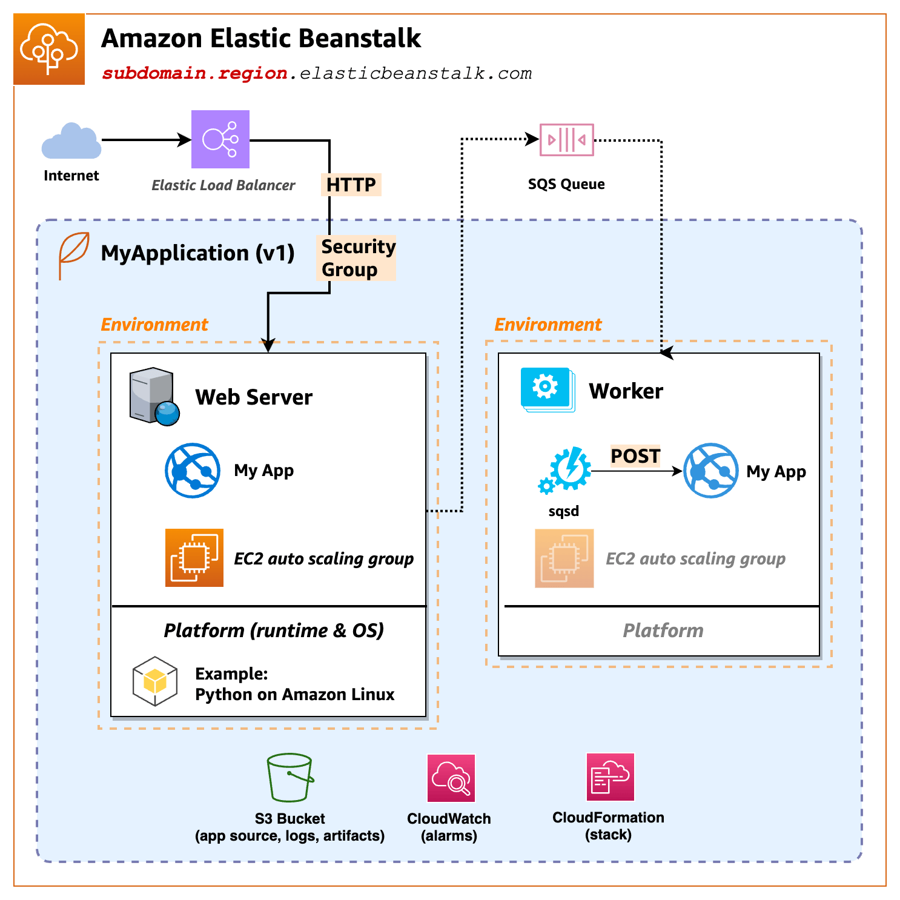

Slide 4
Rails
$ rails new eb-rails --minimal --database=postgresql
$ cd eb-rails
$ bundle lock --add-platform ruby x86_64-linux

Slide 5
config/database.yml
default: &default
adapter: postgresql
encoding: unicode
pool: <%= ENV.fetch("RAILS_MAX_THREADS", 5) %>
development:
<<: *default
database: eb_rails_development
test:
<<: *default
database: eb_rails_test
production:
<<: *default
database: <%= ENV.fetch("RDS_DB_NAME", "eb_rails_production") %>
username: <%= ENV.fetch("RDS_USERNAME", "myappuser") %>
password: <%= ENV["RDS_PASSWORD"] %>
host: <%= ENV.fetch("RDS_HOSTNAME", "localhost") %>
port: <%= ENV.fetch("RDS_PORT", 5432) %>

Slide 6
A public/index.html for Testing
<html>
<head><title>Testing</title></head>
<body><h1>Testing</ht></body>
</html>

Slide 7
Commit
$ git add .
$ git commit -m "Initial"

Slide 8
Creation
$ eb init # Use defaults, say no to CodeCommit
# and no to ssh
$ eb create production-env \
--database.engine postgres \
--database.username myappuser \
--database.password 'S0m3Str0ngPass' \
--envvars "SECRET_KEY_BASE=$(bin/rails secret),RAILS_ENV=production,RAILS_LOG_TO_STDOUT=true,RAILS_SERVE_STATIC_FILES=true"

Slide 9

Git Some Coffee or Espresso

Slide 10
Finally
2025-12-05 17:26:25 INFO Instance deployment completed successfully.
2025-12-05 17:26:29 INFO Application available at production-env.eba-ajhunfdw.us-west-2.elasticbeanstalk.com.
2025-12-05 17:26:30 INFO Successfully launched environment: production-env
$ eb open

Slide 11
Changes
$ git commit –am “…”
$ eb deploy
# Refresh browser page

Slide 12
Useful Commands
$ eb status # Check environment status
$ eb logs # View application logs
$ eb ssh # SSH into the instance
$ eb list # List all environments

